Slide 1
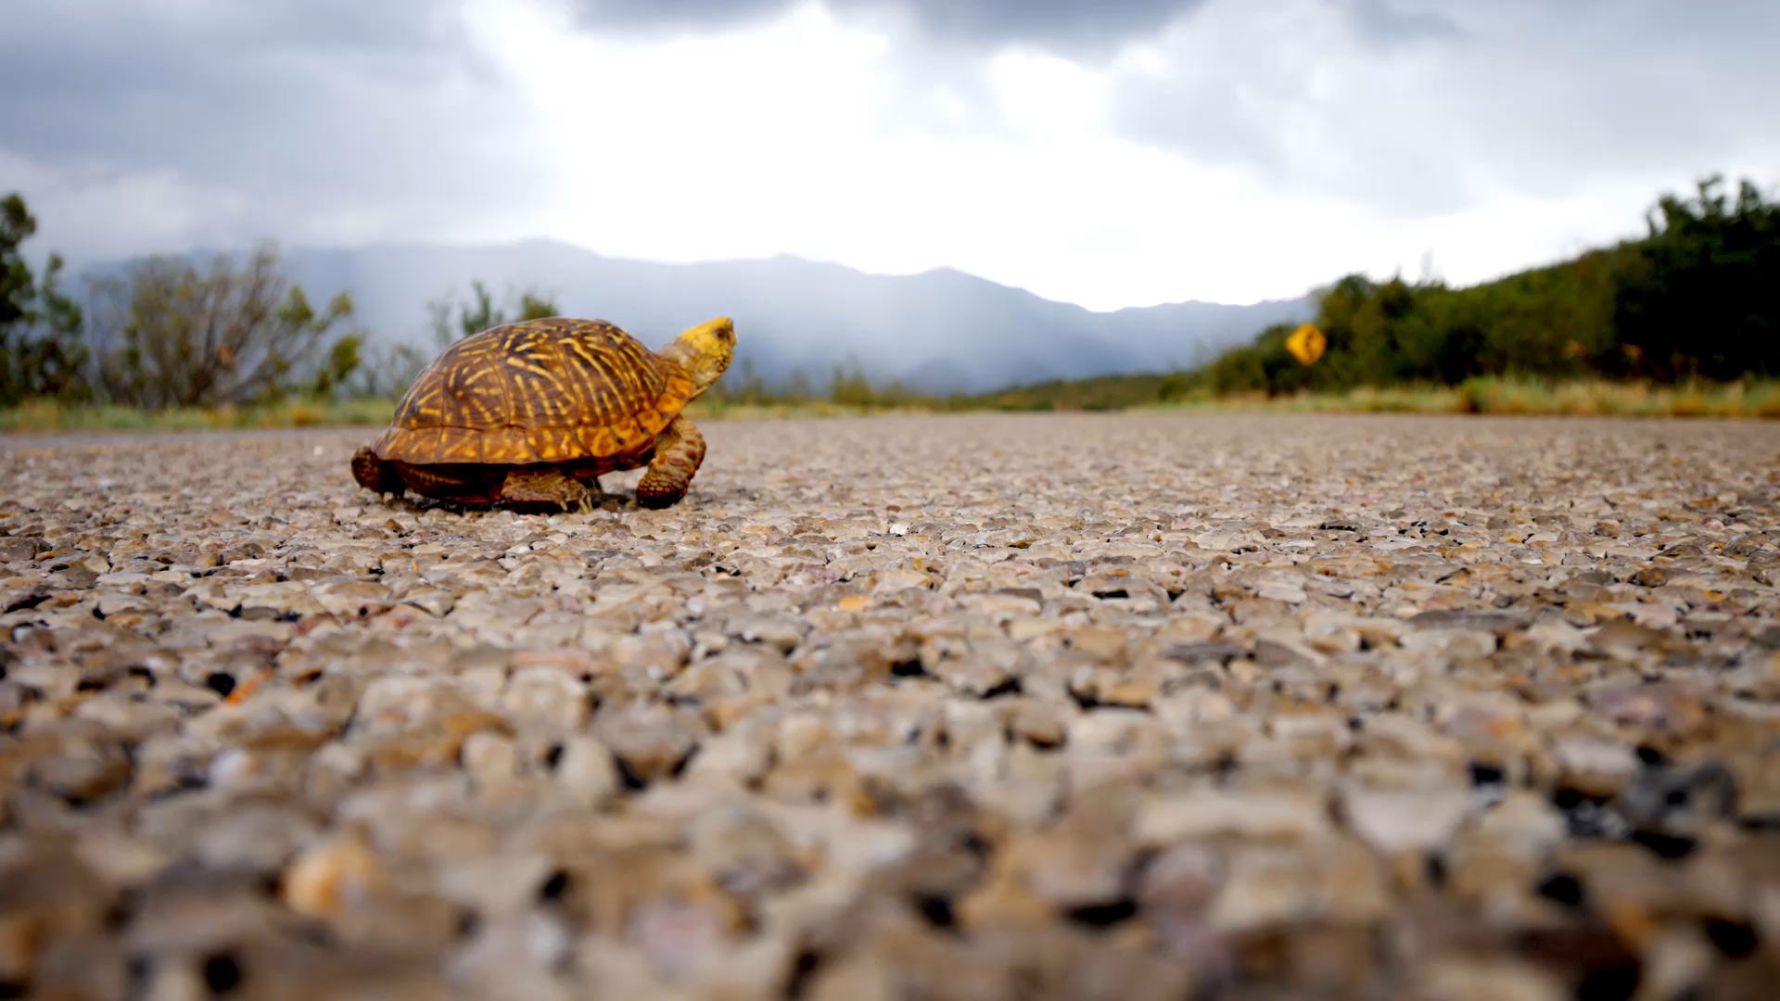
NATURE CRAWLS
By Gabriel Camara, Tyrique Forbes, William Hughes and Corbin Kruger

Slide 2
About Us
Gabriel Camara
Tyrique Forbes
William Hughes
Corbin Kruger
I am an aspiring game developer born and raised in South Africa. I am a male who is 21 years old. I worked on the UI and menus, the enemies and round system, as well as putting all the aspects of the game together once the mechanics or models were finished by my group mates.
I am an aspiring South African developer, born and raised. I am a 22-year-old male. I mainly worked on the weapon system, weapon combos, player and enemy stats system, player movement and general game feel as well as helping in other areas where needed.
I am an aspiring game artist and 3d modeler, 21 years old male. I worked on the art and game assets along with Corbin, and the animations for both the enemy models as well as the player’s weapon attacks.
Art ☺ :3. I am a 21-year-old male. I worked on the art and game assets along with William, and Level design for the first level.

Slide 3

Overall Game Description
Nature Crawls is an arena shooter.
First Person Shooter Singleplayer.
The player is a nature conservationist.
Enemies are the CCP(Counter Conservation Project).
Impeccable graphics.
Smooth gameplay.
Notes:
Gabe

Slide 4

The Goal of Our Game(Promoting Nature Conservation)
The main goal of our game is to promote nature conservation.
South Africa struggles with nature conservation, specifically:
Poaching
Deforestation
Overfishing
We promote this issue through appealing to a younger audience.
Focusing on fun rather than purely focussing every aspect of gameplay on the message
Entertainment encourages engagement with the message.
Notes:
Corbin

Slide 5

Game Engine and Platform
The game is made in Unreal Engine 5
The platform is PC
Notes:
Gabe

Slide 6
Key Features
Combat
Attractive Women
Cool weaponry
Movement
Entertaining Story
Beautiful Environments
Notes:
Tyrique

Slide 7
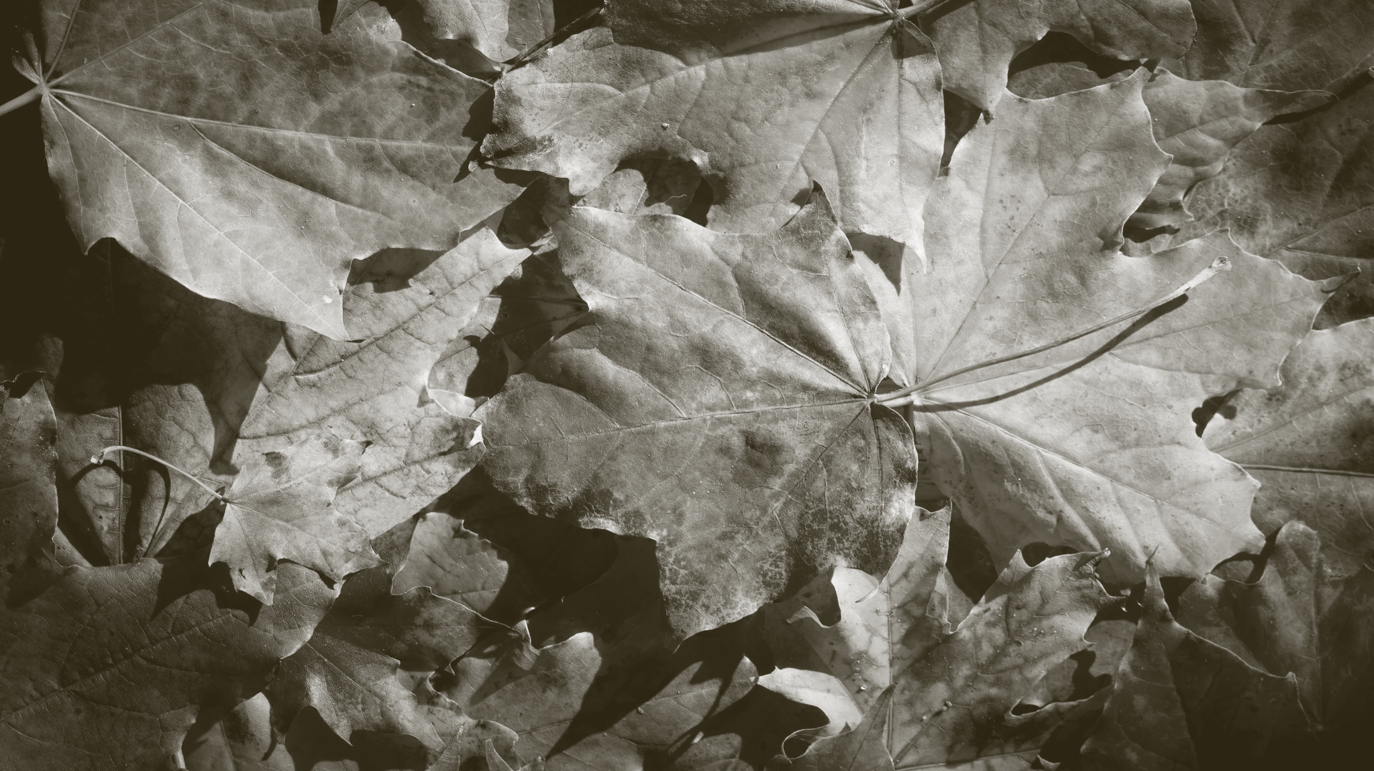
Story and Setting
A far future where almost all of Earth’s natural beauty is gone, its resources harvested.
A large megacorporation aiming to gather what little natural resources are left, destroying the little beauty left in the world.
A silent ranger, watching over this pristine landscape
The others who keep it functioning
Notes:
you are a nature conservationist who was well renowned for his achievements and also has the ability of soul merging that allowed him to merge with the big five and use their weaponry

Slide 8

Art style direction
The art style for the game was heavily influenced by games like ULTRAKILL and Risk of Rain 2
We wanted to have as little information on the screen to immerse the player into the high-octane gameplay
When examining other roguelike games, we observed that they all had brighter colour palettes, so we chose to incorporate brighter tones into our UI
Notes:
For UI, we like brighter and wilder designs for our games UI

Slide 9
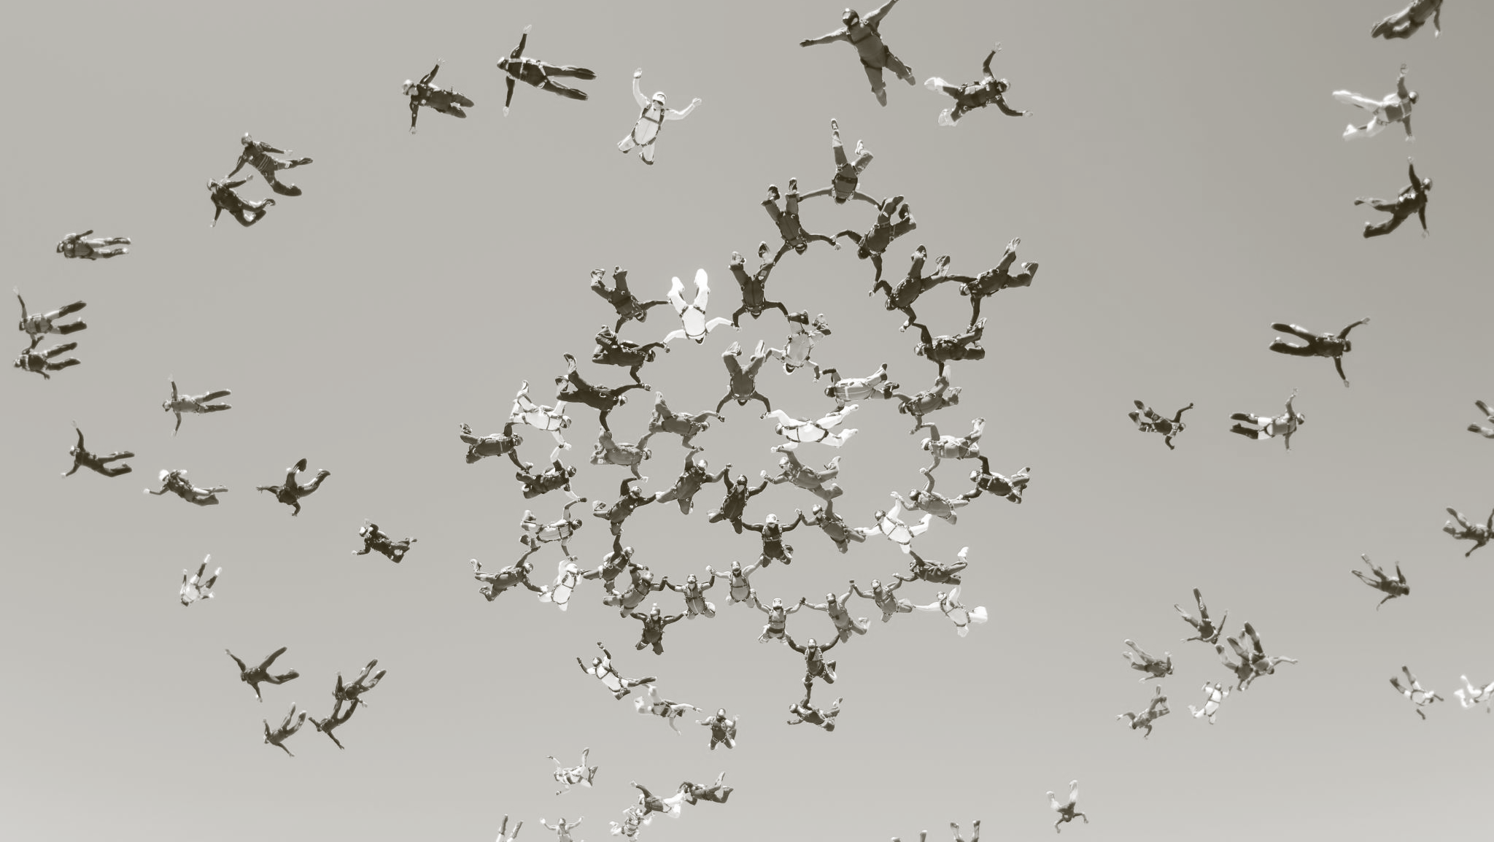
Demographic and Player Type
Individuals aged between 16-25
Enjoy fast paced games
Enjoy leaderboards and challenges
Notes:
Gabe

Slide 10

Audio
We chose the “Breakcore” genre of music for our background music as it fits the high octane and fast gameplay
We chose to go for more lighthearted and funny sound effects to as it felt like it matched the tone of our game
Notes:
We chose funny sound effects even though conservation is serious as players are more likely to listen to the message if the game is fun

